Slide 1

Piece by Piece
Neighborhood Investment Conference
Learning from Phoenix
German Reyes
VP, Community Stabilization

Slide 2
Who is Chicanos Por La Causa (CPLC)?
501(c)3, Founded in 1969
  Now one of the largest Hispanic Community Development Corporations in the United States
  Approximately 750 employees
HQ in Phoenix; Operations in AZ, NV and NM
Highly diverse nonprofit with 4 business “pillars”
  Social Services
  Education
  Economic Development
  Housing
Housing Counseling Agency certified in Phoenix for 27 years
Housing Counseling Agency in Las Vegas
  Established in 2010
  Freddie Mac Center
Notes:
Section 3 of the Housing and Urban Development Act of 1968 recognizes that the normal expenditure of certain HUD funds typically results in new jobs, contracts, and other economic opportunities; and when these opportunities are created, low- and very low-income persons residing in the community in which the funds are spent and the businesses that substantially employ them, shall receive priority consideration.
Section 3 is a starting point to obtain job training, employment, and contracting opportunities. Section 3 is a starting point to homeownership. Once a Section 3 resident has obtained employment or contracting opportunities they have begun the first step to self-sufficiency.

Slide 3
CPLC’s NSP2 National Program
Consortium
  1 of 4 National Consortiums as defined by HUD
  13 Nonprofit agencies in 15 markets located in 8 states and D.C.
  $137M – largest grant ever to a Latino-based CDC
  CPLC Lead Agency due to capacity (compliance, legal, audit, F/A)
Focus on:
  Results! (Strict Expenditure Deadlines, and entirely affordable markets)
    50% Expenditure in 24 months (Investor Activity a challenge → led to “First Look”)
  IMPACT – nearly 2500 “national objectives” (mostly SRF) to meet goal
  JOBS! Incredible “jobs” story being told as a result of housing
Strong National Relationships created to assist in REO/delinquent Asset Procurement
  Fannie Mae, NCST, HUD/FHA
  Numerous lenders, banking institutions
Notes:
Section 3 of the Housing and Urban Development Act of 1968 recognizes that the normal expenditure of certain HUD funds typically results in new jobs, contracts, and other economic opportunities; and when these opportunities are created, low- and very low-income persons residing in the community in which the funds are spent and the businesses that substantially employ them, shall receive priority consideration.
Section 3 is a starting point to obtain job training, employment, and contracting opportunities. Section 3 is a starting point to homeownership. Once a Section 3 resident has obtained employment or contracting opportunities they have begun the first step to self-sufficiency.

Slide 4
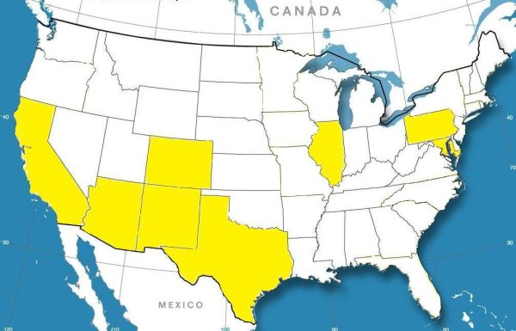
NSP II NATIONAL COALITION
NorrisSquare
CHISPA
CRHDC
TRP
Mi Casa
Del Norte
NEW
CPLC
YES
TDS
El Paso CUSO
AHSTI
CDCB

Slide 5
NSP2 Performance
3 Years are over – How have we done?

Slide 6
National Performance – Results!!
*633 total grantees*
State | Grantee | Appropriation | Grant Amount | PI Drawn | Total Drawn | % Drawn
MI | State of Michigan | NSP2 | $223,875,399 | $8,515,929 | $225,655,621 | 100.8%
AZ | Chicanos Por La Causa, Inc. | NSP2 | $137,107,133 | $51,518,806 | $179,671,193 | 131.0%
CA | State of California | NSP1 | $145,071,506 | $39,503,051 | $171,184,892 | 118.0%
GA | Habitat for Humanity International Inc | NSP2 | $137,620,088 | $0 | $137,620,088 | 100.0%
OH | State of Ohio | NSP1 | $116,859,223 | $2,221,229 | $118,768,063 | 101.6%
CA | Los Angeles, CA | NSP2 | $100,000,000 | $14,206,628 | $112,249,389 | 112.2%
FL | State of Florida | NSP1 | $91,141,478 | $16,864,561 | $103,899,771 | 114.0%
MA | The Community Builders, Inc. | NSP2 | $78,617,631 | $22,802,864 | $101,420,494 | 129.0%
MI | State of Michigan | NSP1 | $97,964,416 | $5,619,335 | $101,117,689 | 103.2%
IL | Chicago, IL | NSP2 | $98,008,384 | $857,141 | $97,997,510 | 100.0%
FL | NHS of South Florida, Inc. | NSP2 | $89,375,000 | $2,547,031 | $91,922,031 | 102.8%
IN | State of Indiana - IHCDA | NSP1 | $83,757,048 | $4,771,471 | $88,528,509 | 105.7%
GA | State of Georgia | NSP1 | $77,085,125 | $23,015,102 | $88,351,744 | 114.6%
TX | State of Texas - TDHCA | NSP1 | $91,323,273 | $3,547,816 | $77,438,728 | 84.8%
CA | Riverside County, CA | NSP1 | $48,567,786 | $35,439,139 | $75,962,368 | 156.4%
AZ | Phoenix, AZ | NSP2 | $60,000,000 | $13,788,691 | $67,183,465 | 112.0%
FL | Dade County, FL | NSP1 | $62,207,200 | $2,632,179 | $63,448,588 | 102.0%
PA | State of Pennsylvania | NSP1 | $59,631,318 | $6,876,454 | $61,671,681 | 103.4%
CA | Los Angeles NHS Inc. | NSP2 | $60,000,000 | $15,228,747 | $58,935,602 | 98.2%
Per HUD Weekly 9/9/2013

Slide 7
National Performance!!
“Program Income” – Leveraging (633 Total Grantees)
State | Grantee | Appropriation | Grant Amount | PI Drawn | Total Drawn | % Drawn
AZ | Chicanos Por La Causa, Inc. | NSP2 | $137,107,133 | $51,518,806 | $179,671,193 | 131.0%
CA | State of California | NSP1 | $145,071,506 | $39,503,051 | $171,184,892 | 118.0%
CA | Riverside County, CA | NSP1 | $48,567,786 | $35,439,139 | $75,962,368 | 156.4%
GA | State of Georgia | NSP1 | $77,085,125 | $23,015,102 | $88,351,744 | 114.6%
MA | The Community Builders, Inc. | NSP2 | $78,617,631 | $22,802,864 | $101,420,494 | 129.0%
VA | State of Virginia | NSP1 | $38,749,931 | $22,368,954 | $51,638,393 | 133.3%
ID | State of Idaho | NSP1 | $19,600,000 | $17,570,385 | $34,687,046 | 177.0%
FL | Neighborhood Lending Partners of West Florida, Inc. | NSP2 | $50,000,000 | $17,436,867 | $58,735,550 | 117.5%
FL | State of Florida | NSP1 | $91,141,478 | $16,864,561 | $103,899,771 | 114.0%
CA | Los Angeles Neighborhood Housing Services Inc. | NSP2 | $60,000,000 | $15,228,747 | $58,935,602 | 98.2%
CA | Los Angeles, CA | NSP2 | $100,000,000 | $14,206,628 | $112,249,389 | 112.2%
AZ | Phoenix, AZ | NSP2 | $60,000,000 | $13,788,691 | $67,183,465 | 112.0%
MD | Healthy Neighborhoods Inc. | NSP2 | $26,092,880 | $12,316,489 | $35,134,012 | 134.6%
CA | Hsg Trust of Santa Clara County | NSP2 | $25,000,000 | $11,354,019 | $30,967,740 | 123.9%
MN | State of Minnesota | NSP1 | $38,849,929 | $11,036,129 | $46,580,506 | 119.9%
(per HUD Weekly 9/9/2013)

Slide 8
NSP2 Performance Dashboard – Results!!

Slide 9
CPLC’s NSP2 National Program - Impact
CPLC has made significant efforts to measure local and national impact of NSP2.
Direct and induced impact is critical to the stabilization of communities
A few highlites for AZ Market:
  CPLC AZ received $32M in NSP2 grant monies (most in consortium)
  NSP2 is forecasted to add $66.33M in gross state product for the period 2010-2013. This is DOUBLE the initial federal investment!
  NSP2 is forecasted to add nearly $40M in real disposable income in the state of Arizona (2010-2013)
  Attribute success at National Level to our deep-rooted CDCs with Housing Counseling Agencies
Notes:
Section 3 of the Housing and Urban Development Act of 1968 recognizes that the normal expenditure of certain HUD funds typically results in new jobs, contracts, and other economic opportunities; and when these opportunities are created, low- and very low-income persons residing in the community in which the funds are spent and the businesses that substantially employ them, shall receive priority consideration.
Section 3 is a starting point to obtain job training, employment, and contracting opportunities. Section 3 is a starting point to homeownership. Once a Section 3 resident has obtained employment or contracting opportunities they have begun the first step to self-sufficiency.

Slide 10
CPLC’s NSP2 National Program – Jobs!
Section 3 extremely important in strategy implementation
  Creating local job opportunities to individuals
  Creating local contract opportunities to contractors
Great success in creating and retaining jobs
Created a measurable outcome illustrating the opportunity of job creation and economic development using federal funds/stimulus…but something that can be replicated in open market
Notes:
Section 3 of the Housing and Urban Development Act of 1968 recognizes that the normal expenditure of certain HUD funds typically results in new jobs, contracts, and other economic opportunities; and when these opportunities are created, low- and very low-income persons residing in the community in which the funds are spent and the businesses that substantially employ them, shall receive priority consideration.
Section 3 is a starting point to obtain job training, employment, and contracting opportunities. Section 3 is a starting point to homeownership. Once a Section 3 resident has obtained employment or contracting opportunities they have begun the first step to self-sufficiency.

Slide 11
Learning from “NSP2” Phoenix
Significant learning from single family REO development (acq, rehab and resale)
Estimation of rehab critical
  25-30% of Acquisition Price was reasonable
CPLC witnessed price increases over the last 2-3 years prior to frantic activity in Phx area
  For example, early on, It was common to leave significant development subsidy…
    TDC: $90,000 acquisition + $30000 rehab -→ sell for $100,000
  Approximately two years ago, values were rising fast:
    TDC: $100,000 acquisition + $30,000 rehab -→ appraised values were greater than $130,000
    Prices increases in excess of 30% when same property was re-sold became common (market trend was noticeably positive)
    Effectively presented a value-proposition for investors
Notes:
Section 3 of the Housing and Urban Development Act of 1968 recognizes that the normal expenditure of certain HUD funds typically results in new jobs, contracts, and other economic opportunities; and when these opportunities are created, low- and very low-income persons residing in the community in which the funds are spent and the businesses that substantially employ them, shall receive priority consideration.
Section 3 is a starting point to obtain job training, employment, and contracting opportunities. Section 3 is a starting point to homeownership. Once a Section 3 resident has obtained employment or contracting opportunities they have begun the first step to self-sufficiency.

Slide 12
Learning from Phoenix
Atlanta & Phoenix Markets

Slide 13
Real Estate Market Snapshot

Slide 14
A Comparison of Markets

Slide 15
A Comparison of Markets
Effective date | S&P/Case-Shiller GA-Atlanta Home Price Index | S&P/Case-Shiller GA-Phoenix Home Price Index
Jun-2012 | 91.75 | 114.68
Jul-2012 | 94.15 | 117.22
Aug-2012 | 95.8 | 119.28
Sep-2012 | 96.06 | 120.65
Oct-2012 | 95.6 | 122.39
Nov-2012 | 95.68 | 124.16
Dec-2012 | 95.95 | 125.33
Jan-2013 | 96.98 | 126.69
Feb-2013 | 97.01 | 128.1
Mar-2013 | 98.25 | 130.29
Apr-2013 | 102.01 | 132.47
May-2013 | 105.51 | 134.97
Jun-2013 | 109.15 | 137.36
Jul-2013 | 111.54 | 139.36

Slide 16
Snapshot Stats-Phx/Atl
Market Summary
There are currently 9,113 properties in Phoenix, AZ that are in some stage of foreclosure (default, auction or bank owned) while the number of homes listed for sale on RealtyTrac is4,607.
In August, the number of properties that received a foreclosure filing in Phoenix, AZ was 0% higher than the previous month and 65% lower than the same time last year.
Home sales for July 2013 were up 13% compared with the previous month, and up 6% compared with a year ago. The median sales price of a non-distressed home was $164,500. The median sales price of a foreclosure home was $125,000, or 24% lower than non-distressed home sales.
Sales Prices - Phoenix, AZ
Foreclosure Discount
$39,500( 24.0%)
3.9% ( $1,500) vs Jul 2012
Market Summary
There are currently 4,258 properties in Atlanta, GA that are in some stage of foreclosure (default, auction or bank owned) while the number of homes listed for sale on RealtyTrac is4,370.
In August, the number of properties that received a foreclosure filing in Atlanta, GA was 35% lower than the previous month and 66% lower than the same time last year.
Home sales for July 2013 were up 17% compared with the previous month, and up 38% compared with a year ago. The median sales price of a non-distressed home was $224,200. The median sales price of a foreclosure home was $92,000, or 59% lower than non-distressed home sales.
Sales Prices - Atlanta, GA
Foreclosure Discount
$132,200( 59.0%)
www.cplc.org

Slide 17
Snapshot Stats
Phoenix-Mesa-Glendale, AZ Metropolitan Statistical Area
Forecast change: first quarter, 2013 - first quarter, 2014 | +5.1%
Forecast change: first quarter, 2014 - first quarter, 2015 | +2.9%
Market fundamentals
Median Family Income (First quarter 2013) | $60,700
Median Home Price (First quarter 2013) | $192,000
Change in Home Prices (From First quarter 2012 through First quarter 2013) | +22.8%
Worst 1-Year Home Price Change (1980-2013) | -35.7% (2009:Q1
Forecast as of August, 2013, courtesy of CoreLogic.

Slide 18
Snapshot Stats
Atlanta-Sandy Springs-Marietta, GA Metropolitan Statistical Area
Forecast change: first quarter, 2013 - first quarter, 2014 | +4.9%
Forecast change: first quarter, 2014 - first quarter, 2015 | +3.3%
Market fundamentals
Median Family Income (First quarter 2013) | $66,200
Median Home Price (First quarter 2013) | $146,000
Change in Home Prices (From First quarter 2012 through First quarter 2013) | +19.2%
Worst 1-Year Home Price Change (1980-2013) | -17.6% (2012:Q1
Forecast as of August, 2013, courtesy of CoreLogic.

Slide 19
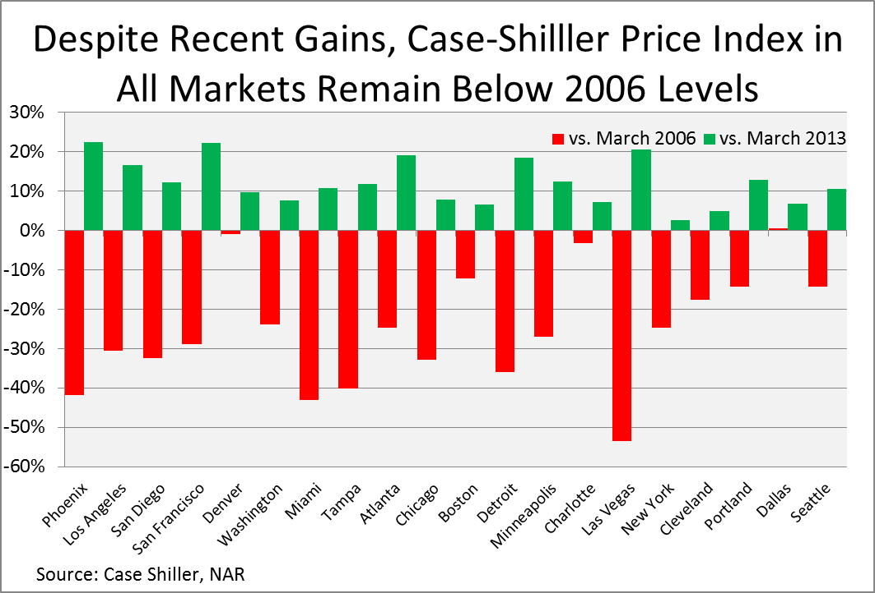
More than half of the markets in the index, 14, were down by 20%
  or more compared to March of 2006 and
Las Vegas was down in excess of 53%.
Markets in California and the sand states of Florida, Nevada and Arizona were down by the largest amounts despite frenzied investor purchases.

Slide 20
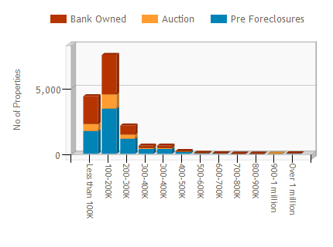
Number of Properties per estimated market
Highest Availability
$100-200K/7,552 Properties

Slide 21
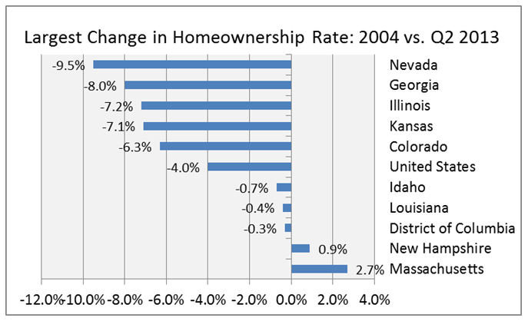
The national homeownership rate peaked at 69% in 2004, but fell four percentage points to 65% in the 2nd quarter of 2013.
Despite having experienced the large number of foreclosures in California and Florida, those states are not among the top five states in terms of change in homeownership, though Nevada is.
Markets with the Largest Change in Homeownership Rate
Nevada Homeownership rate = 53.3% 2nd QTR 2013

Slide 22
Investor Activity (buy vs rent)
If I’m an investor, do I continue to buy?
It’s all about location
What is the Area Median Income? What is the Median Home Price for the area?
Maximum ratios used to compute housing expense
  For example:
    $60,000 = AMI for a family of 4 (Phx AMI = $60,700)
    Equates to $5000 gross / month
    Equates to $1500 / mo as a Housing Expense (per 30% ratio)
    M*I = $1200 if T&I&HOA, etc = $300/mo (approx 20%)
    At 3.5% DP, a 30 year, 5.5% mortgage allows a family to purchase:
      $219,000!
      P&I payment = $1199.94

Slide 23
Investor Activity
In Phoenix, recall:
  Median Home Price = $192,000
  “Affordable” Price point = $219,000
  Represents an upside of: $27,000 or 14%
In Atlanta, recall:
  Median Home Price = $146,000
  Area Median Income = $66,200
  Using similar approach, P&I = $1320 (Housing Expense Max)
  This represents an “Affordable Price” = $241,000
  Represents an upside of: $95,000 or 65%!
Note: Housing Expense Max is also related to maximum lease/rent amount! So analyzing Fair Market Rents provides a rental strategy as well.

Slide 24
Rental as a Temporary exit strategy
Maricopa County, Arizona
 | Efficiency | 1 Bedroom | 2 Bedrooms | 3 Bedrooms | 4 Bedrooms
Final FY2013 FMRs (per HUD) | $593 | $748 | $925 | $1,363 | $1,592
Fulton County, Georgia
 | Efficiency | 1 Bedroom | 2 Bedrooms | 3 Bedrooms | 4 Bedrooms
Final FY2013 FMRs (per HUD) | $676 | $737 | $874 | $1,158 | $1,406
Take Phoenix Example: Purchase for $192,000
Rent = $1592 -> 20% Expense -> $1,274/mo rent
Equates to $15,283 annual rents = 8% return!

Slide 25
Investor Activity
Is it good?
Is it stabilizing neighborhoods?
  Yes, certainly initially.
    Investments spurs confidence if capital infused in economic development, jobs, etc.
    Begins to create a bottom to local housing prices
    Neighborhood “Confidence”
  Long term – if left as rental, perhaps not so good
Where is the wealth? Especially for disproportionately affected communities predominantly Latino or African American?
  Investors strip wealth from communities. So what’s the balance?
Neighborhood
  Homeownership typically preferred over rentership. Why?
    Assume “pride of ownership” when you own vs rent
    Homeowners are vested in their community (schools, church, etc)
  Renters – are they preferable to vacancy?
    If Pride of Ownership exists with tenants – yes. If not, maybe vacancy preferred if property is maintained by owner
    Why lease with option to buy makes sense…tenant has a vested interest in the property
Constrained Demand
  Creates Opportunity for new construction
In submarkets, Investors can drive the market
  Certain areas may be prone to downward pressure if investors “dump” their inventory
  Can we create a “hybrid” model where Investors incorporate non profit developers into their model?

Slide 26
A Happy Medium?
How do we (ie. Non profits) work with investors?
Offer them a channel to procure qualified homebuyers or:
  Lease to own tenants/buyers
  Counseling/HBE incredibly important for potential homeowners, especially FTHB
  Exit strategy for the investor?
    Sell underperforming assets to local nonprofits?
Make them “socially-minded”
  Walk the talk
    Investors “say” they are mindful of markets, etc.
    Clear that they are purchasing ‘commodities’ when they make decisions
  Set aside a portion of their homes for low income?!?
  Creative strategy for investors as they look to bid/win large FHA pools
Certain Submarkets may present a very effective partnership as other subsidies may be inserted by the non profit
  Non profit can effectively assist in hedging an investor’s “downside”

Slide 27
Muchas Gracias!

