Slide 1


The Role of Investors in the Single-Family Market in Lower-Income Neighborhoods:
Lessons from Atlanta
…and from Cleveland, Las Vegas, and Boston
Piece by Piece
Neighborhood Investment Conference
October 10, 2013
Dan Immergluck
Professor
School of City and Regional Planning
Georgia Tech

Slide 2
Likely REO-Investors Ownership Disproportionately Concentrated in Lower-Income Neighborhoods
Level of Likely REO-Investor Ownership, December 2011
City of Atlanta
No DSF Parcels
0 – 0.8%
0.8 – 5.9%
5.9 – 12%
12% +
LRI
MRI
HRI
VHRI

Slide 3
Demographics and REO-Investor Activity
by Neighborhood Type
 | LRI | MRI | HRI | VHRI
median % African-American (2010 Census) | 10.6% | 83.6% | 90.1% | 94.4%
median poverty rate (2006-2010 ACS) | 3.6% | 16.7% | 36.2% | 40.1%
median vacancy rate (2010 Census) | 7.9% | 13.7% | 20.6% | 33.8%
% REO sales to likely investors, 2010-2011 | 14.0% | 27.3% | 47.3% | 46.1%
% REO sales to investors to small investors, 2010-2011 | 87.1% | 68.0% | 59.3% | 67.6%
median price of REO sales, 2010-2011 | $131,850 | $40,000 | $18,593 | $14,750
% REO sales to investors 2009-2010, resold w/in 1 yr | 42.7% | 32.3% | 28.5% | 26.5%
% REO sales to investors 2009-2010, w/in 1 yr to investor | 4.4% | 8.8% | 16.2% | 17.0%
Notes:
14,360 REO sales in 2008-200; 10,061 in 2010-2011
Decline partly due to suburbanization of foreclosure crisis and sub→ prime
LRI tracts are predominantly white (median 10.6%), low poverty, low-vacancy
HRI and VHRI tracts are pred A-A (over 90% median), high poverty, and high vac
3) % REO to investors much higher in HRI/VHRI tracts (~50% vs. 14% in LRI)
4) Of sales to investors, 11-13% to med/big investors in LRI, closer to 35-50% in HRI/VHRI
5) ~1/3 of REO properties purchased by investors in 2009/2010 were resold within one year
Investors in LRI tracts were 50-60% more likely to resell within one year compared to those in VHRI tracts
6) 10% of flips by investors in LRI tracts were to other investors; 57% in HRI tracts and 64% in VHRI tracts

Slide 4
Largest Buyers of REO, Fulton County, 2008-09 and 2010-11
20 LARGEST INVESTOR BUYERS OF REO, 2008-09 | # OF REO PURCHASES 2008-09 |  | 20 LARGEST INVESTOR BUYERS OF REO, 2010-11 | # OF REO PURCHASES 2010-11
JOHN GALT ENTERPRISES LLC | 99 |  | HARBOUR PORTFOLIO LP | 49
BLUE SPRUCE ENTITIES LLC | 70 |  | ATLANTA NEIGHBORHOOD DEV PARTNERSHIP INC | 44
ALAIMO ANTHONY | 53 |  | CPI HOUSING FUND LLC | 39
DOUG COKER PROPERTIES LLP | 52 |  | HABITAT FOR HUMANITY IN ATLANTA INC | 37
RDM HOLDINGS LLC | 50 |  | APD SOLUTIONS FULTON LLC | 35
PAVILACK INDUSTRIES INC | 49 |  | TOP RENTAL RETURNS LLC | 31
WESTLINE MANAGEMENT COMPANY LLC | 47 |  | ALAIMO ANTHONY | 29
B & Z INVESTMENTS LLC | 44 |  | EQUITY TRUST COMPANY | 28
STONECREST INCOME & OPPORTUNITY FUND | 44 |  | USA RENTAL FUND LLC | 26
CF TWENTY FOUR LLC | 37 |  | TRR ATLANTA LLC | 23
MID GROUP LLC | 36 |  | INTERCONTINENTAL ACQUISITIONS LLC | 23
ATLANTA REAL ESTATE INSIDERS LLC | 36 |  | ORCHARD TERRACE ESTATES LLC | 19
NATIONAL ASSET MANAGEMENT GROUP | 34 |  | ASSET MANAGEMENT & INVESTMENTS LLC | 16
BIRKHOLZ JOHN | 33 |  | CSF ENTERPRISES LLC | 16
PROPERTY ACQUISITIONS INVESTMENTS LLC | 32 |  | KIDDER PROPERTIES LLC | 15
MORRIS ROYCE | 32 |  | HYC FINANCIAL LLC | 14
HABITAT FOR HUMANITY IN ATLANTA INC | 31 |  | STONECREST INCOME & OPPORTUNITY FUND | 14
SOUTHERN DEVELOPMENT HOLDINGS GROUP | 30 |  | AFFORDABLE HOUSING ASSISTANCE INC | 13
GRINMARD GROUP INC | 30 |  | ELEVON PROPERTIES LLC | 13
SB HOLDINGS LLC | 28 |  | REVITALIZE DEVELOPMENT LLC | 13
Market share of top 10 (of all likely investors): | 9.9% |  | Market share of top 10 (of all likely investors): | 12.2%
Market share of top 20 (of all likely investors): | 15.7% |  | Market share of top 20 (of all likely investors): | 17.8%
Notes:
Highly distributed – top 10 buyers only about 10% of investor purchasers

Slide 5
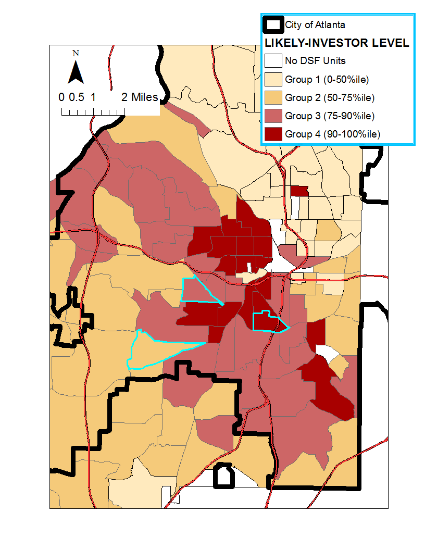
No DSF Units
LRI Tracts
MRI Tracts
HRI Tracts
VHRI Tracts
Interviewing Investors Active on the South/Southwest Side
CBD
60
63
76.02
Tract 60 = Westview
Tract 63 = Pittsburgh
Tract 76.02 = Venetian Hills

Slide 6
Mallach’s Investor Types
-- Modified for Southwest/South Atlanta

Slide 7
Learning from conversations with Atlanta investors…
Acquisition factors: crime, vacancy, homeownership rates
All-cash financing typical
In lower-income neighborhoods, investors generally preferred Housing Choice Vouchers (HCVs) -- stability of the rental stream
Problems with property managers; some vertically integrate; others try to align incentives and use close oversight
Investors did not complain about excessive code enforcement; lack of enforcement as a major problem
Larger investors appeared to be generally avoiding “distressed” neighborhoods

Slide 8
 | Atlanta | Cleveland | Las Vegas | Boston
Typical All-In Costs | Under $75k | Under $50k, often less | Under $150-200k | Over $150k
Investor Characteristics | Mostly small; occasional bulk buying | Mostly small; some bulk buying | Mostly small, many foreign investors | Local investors; somewhat more concentrated
Investor Strategies | Switched from flipping to buy-to-rent | Flipping; little buy-to-rent | Buy-to-rent dominant | Buy-to-rent; higher prices may lead to quicker exits
Rehab Activity | HCVs important advantage in buy-to-rent, allow for more rehab | More than minimal rehab requires subsidy | Newer stock requires less rehab | Routine substantial rehab when property in poor condition
Financing | Mostly cash | Mostly cash | Mostly cash | Cash common but also hard money; refinancing via community banks

Slide 9
Lessons for Practice and Policy
Investor behavior fluid – function of market conditions
NSP-type/gut rehab generally not viewed as sustainable for buy-to-rent; standards and cost-structures must be realistic and sustainable
Housing and vacant property code and enforcement provide critical context for local investor behavior
In lower-income neighborhoods, substantial rehab for buy-to-rent not always feasible without subsidy (e.g., HCV)
  Need for new sources of sustainable financing/subsidy?
  Need quality control/inspections
Need for partnerships/methods to bring institutional investors into distressed neighborhoods in responsible ways

