Slide 1
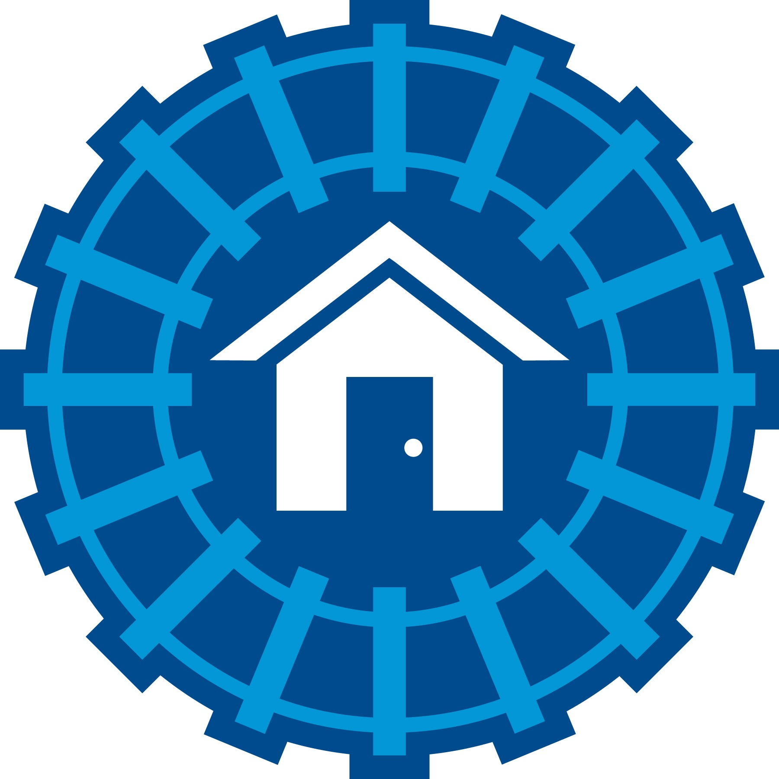
Comparing Volume & Prices between
Adair Park(Southwest) & Collier Hills(Buckhead)
Adair Park Sales in 2015 = 2
Adair Park Sales in 2014 = 17
Adair Park Sales in 2013 = 11
Adair Park Sales in 2012 = 14
Data supplied by: The Beltline Team

Slide 2
Comparing Volume & Prices between
Adair Park(Southwest) & Collier Hills(Buckhead)
Adair Park Sales in 2015 = 2
Adair Park Sales in 2014 = 17
Adair Park Sales in 2013 = 11
Adair Park Sales in 2012 = 14
Data supplied by: The Beltline Team

Slide 3
Comparing Volume & Prices between
Adair Park(Southwest) & Collier Hills(Buckhead)
Collier Hills Sales in 2015 = 0
Collier Hills Sales in 2014 = 17
Collier Hills Sales in 2013 = 11
Collier Hills Sales in 2012 = 14
Data supplied by: The Beltline Team

Slide 4
Comparing Volume & Prices between
Adair Park(Southwest) & Collier Hills(Buckhead)
Collier Hills Sales in 2015 = 0
Collier Hills Sales in 2014 = 17
Collier Hills Sales in 2013 = 11
Collier Hills Sales in 2012 = 14
Data supplied by: The Beltline Team

Slide 5

ANDP Leveraging Effect in Douglas County Target Area, 2010-2013
Year | Number of N'Hoods with ANDP Sales Activity | Qualified Home Sales in ANDP N'Hoods | Total ANDP Home Sales | Average Market Value of Non-ANDP Home Sales | Average Market Value of ANDP Sales | Average Differential: ANDP vs Otherwise | ANDP Market Share | Market Value Increase Per Home | Average Percent Increase Per Home | Total Homes in ANDP Sales N'Hoods | Projected Value Increase Across All Homes | ANDP Improvement Costs | Leverage Ratio
2010 | 8 | 84 | 12 | $ 98,617.69 | $129,400 | $30,782 | 14.30% | $ 4,397.47 | 4.46% | 1240 | $ 5,452,865.56 | $481,787 | 11.32
2011 | 9 | 139 | 10 | $ 59,127.27 | $92,060 | $32,933 | 7.20% | $ 2,369.26 | 4.01% | 1723 | $ 4,082,236.80 | $430,772 | 9.48
2012 | 9 | 145 | 14 | $ 80,605.90 | $96,020 | $15,414 | 9.70% | $ 1,488.33 | 1.85% | 1764 | $ 2,625,408.52 | $519,329 | 5.06
2013 | 15 | 109 | 17 | $ 89,720.95 | $100,765 | $11,044 | 15.60% | $ 1,722.60 | 1.92% | 1441 | $ 2,482,273.53 | $871,480 | 2.85
4-Year Period |  |  |  |  |  |  |  |  |  |  | $14,642,784.40 | $2,303,368
*As a product of ANDP's Market Share and Average Differential Per ANDP Home
**Based on calculation of 3,974 total parcels in 30-neighborhood Target Area
***Including Rehab, Soft Costs, and Developer Fees

